Slide 1

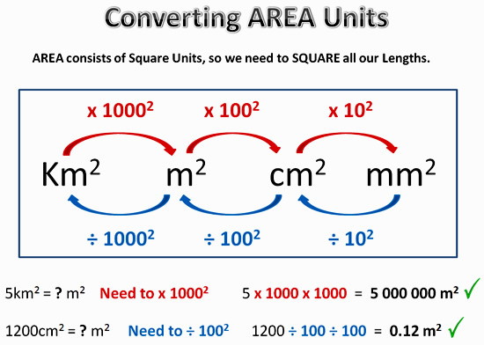
My Measurement Interactive Notebook
Name
Class
Teacher Mr Evans
Term 1 Semester 1
1

Slide 2
Contents
Glossary or Formula Page
Page
Date
Description
2
3

Slide 3
Tasks
24
7
30
Essential Question
Questions
Notes
Summary
6
7

Slide 4
Area demo
Parallelogram demo
Trapezium demo

Slide 5
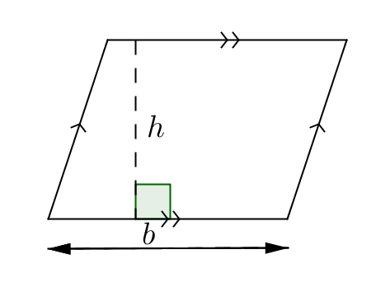
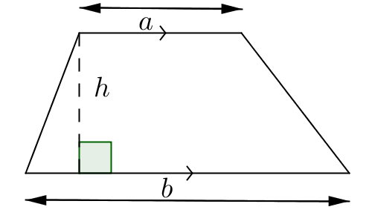



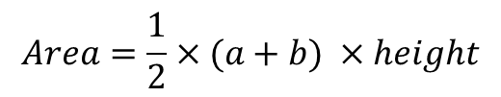
24
7
30
Date
Area of parallelograms and Trapeziums
EQ – Describe how to calculate the areas of different quadrilaterals.
$$Area=base ×height$$
$$A=bh$$
$$Area=\frac{1}{2}×(a+b) ×height$$
$$A=\frac{1}{2}(a+b)h$$
5

Slide 6
Examples

Slide 7
Notes Review
24, 7 ,30
Date
Title
Essential question
Notes complete
Notes complete with colour and diagrams
Questions completed
Contents page filled in
Formula page filled in

Slide 8
Homework
Review your notes and write a summary answering the essential question.

